Slide 1
Stan Honey’s Pacific Cup Weather and Tactics Agenda:
Standard, ebb-tide, Farallon Race first leg.
Get to the Synoptic Wind before the glass-off the first night.
Pick and race to your Ridge Waypoint.
Carefully deal with Cutoff Lows
Slot-cars to the shift, ideally on “Ocean DW” angles
Squalls and Cloud Streets in the trades
Pick the correct corner on the Run
Approaching the Finish

Slide 2
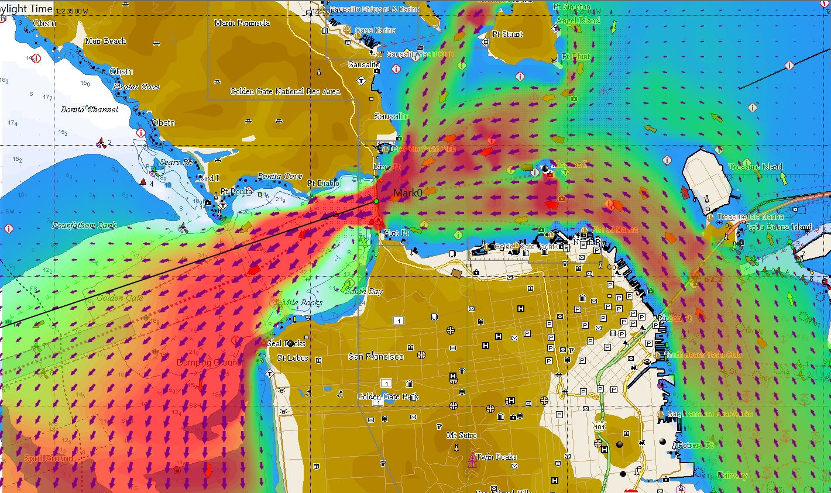

Slide 3
Reach the Synoptic Wind before the inshore glass-off.
Stay in the favorable ebb, know where it is.
Take advantage the wind shift near Pt. Bonita, if in the normal WNW wind.
Don’t sail in the left shifted wind off Seal Rocks and spend the night slatting in the Montara Hole.
Know where the Synoptic wind is, and get there before the inshore thermal wind quits. Nothing else matters until you get into the synoptic wind. (aka gradient or system wind)
There are good pay mesoscale models useful before the prep signal, (PWG, PWC, NAM, NAM Hires, HRRR, various WRF) Choose your mesoscale model by watching for previous several days.
Free mesoscale data sources: Coamps and NAM are both good. US Gov doesn’t charge but be sure to find a free source such as Saildocs or Noaa Ready, among others.
You will smell the synoptic wind when you reach it. Then you’re off on the race to the ridge. Don’t use mesoscale models when in the synoptic wind.

Slide 4
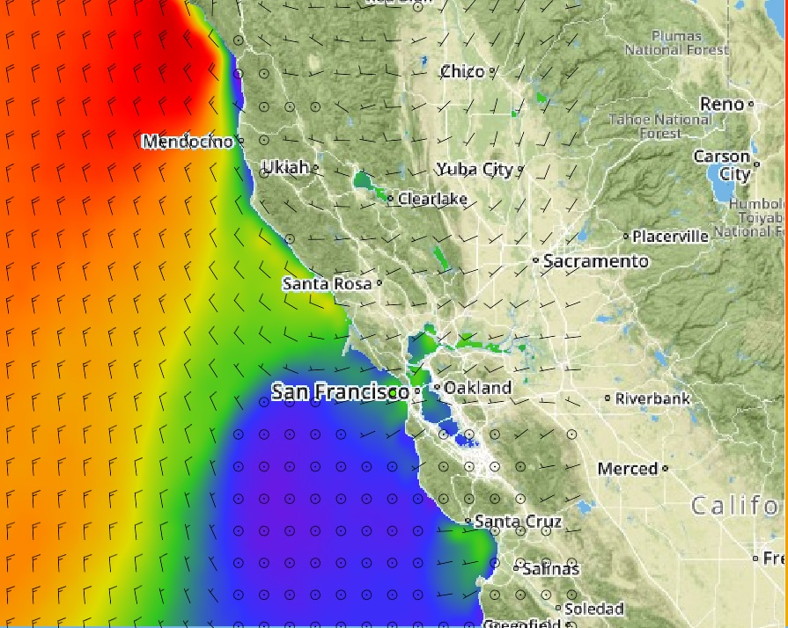

Slide 5
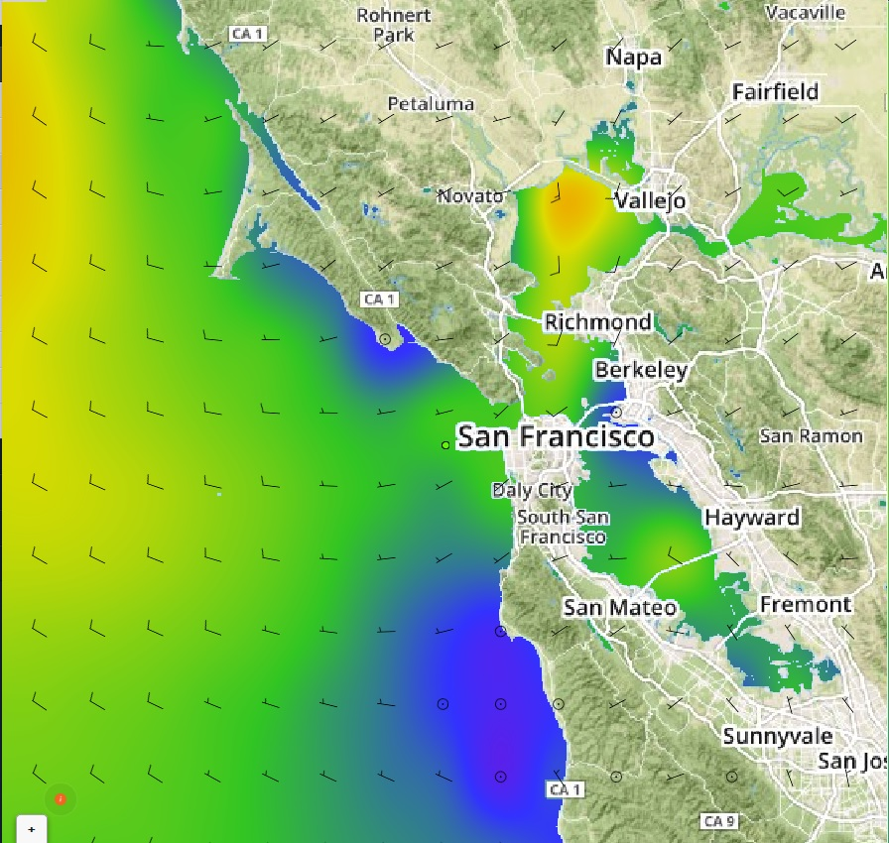

Slide 6
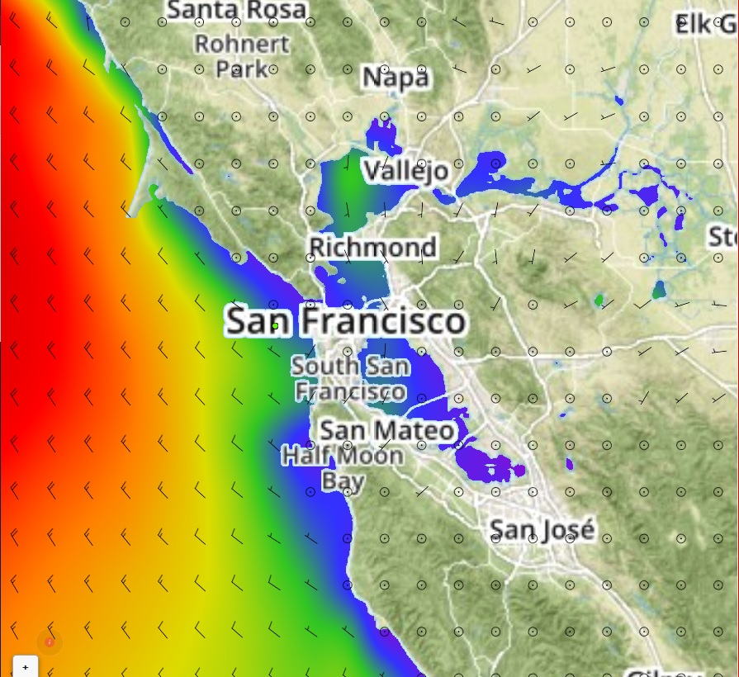

Slide 7
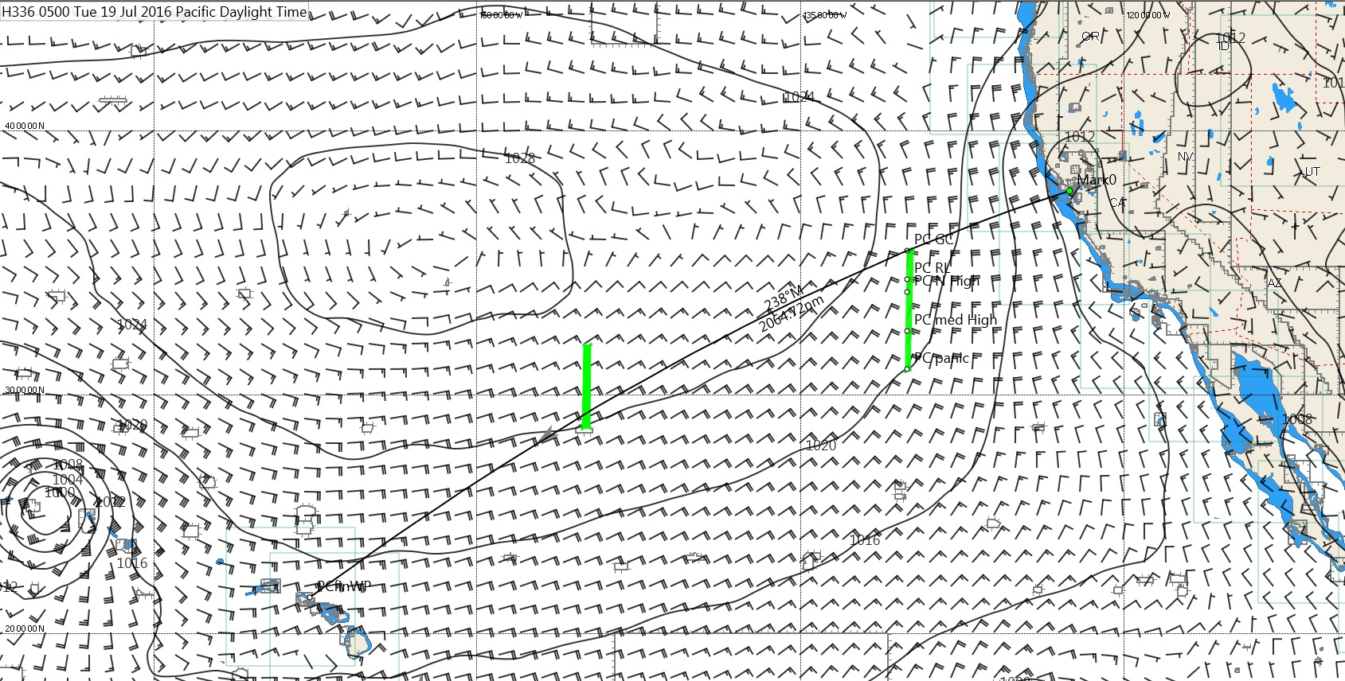

Slide 8
Pick Waypoint on the Ridge
Too far North: wind gets too light before you get to the shift so you have to gybe out on an unfavorable angles. Or you sail slowly in light air, in denial.
Slightly too far North: you have to sail inshore vmg angles. That is slower than sailing slightly hot offshore downwind angles to the lift.
Too far South: you sail extra miles needlessly. The boats to North have just as much wind, sail fewer miles, get the shift first, gybe out on port, and cross in front of you.
To win you have to get it right and cross the ridge at the right place.
Pick based on expected strength and location of High when you are 130-145 lon. Use UL charts, GFS gribs, 96 hr fax progs.
Router will take you too far North. Understand why. Still useful. Use router as a N wall.
Possible waypoints on ridge, 130 Lon
36N GC 0 nm 236mag note course is right past Farallon Island
34.5N RL +9nm 226mag only if extreme N High
34N +16nm 223mag normal N High
32.5N +50nm 215mag med High
31N +110nm 206mag really expensive, sometimes req

Slide 9
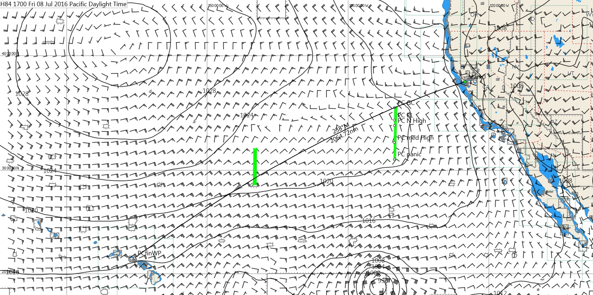

Slide 10
Sources of Weather
Only use free sources of weather after Prep Signal; see RRS41 and the communications restrictions in the SI. Don’t cheat. Ok to pay for satellite comms. Prohibited to pay for data or to get custom data.
Free GFS data is widely available via saildocs and several other services. Don’t break the rules by paying for it. GFS now has 4D initialization.
Coamps is free and is a good mesoscale model. Other for-fee mesoscale models are also useful but only before your prep signal.
Don’t use GFS in terrain effects and don’t use mesoscale models when in synoptic weather.
Do look at the OPC (weatherfax) charts.

Slide 11
Weather Briefing
Don’t let Lee use up all the time with a standard meteorology course presentation. Interrupt Lee, and force him onto timely topics relevant to the upcoming race.
Don’t ask Lee where to go. You folks are the skilled sailors, navigators, routers.
Do ask Lee questions about the weather forecast; he is an extremely good meteorologist. Make him work.
If the High might be stronger than forecast on the gribs, what is the first sign? (UL omega block).
If the High might be weaker than forecast on the gribs, what is the first sign? (UL zonal flow).
How do I estimate the sea state in the vicinity of that hurricane if it comes? (OPC charts)
Which NOAA or Navy mesoscale model is working best off the coast in the last few days? (NAM or Coamps)
How dependably does the GFS forecast the strength of a Tropical (GFS dramatically understates the wind in a tropical)

Slide 12
Routing software
Expedition is the best choice to learn if you are not already familiar with another program. Good routing, fleet tracking, and weather viewing. Also good inshore and starting tool. Familiar “Windows” interface.
Adrena, very good weather analysis, ok routing, very good for routing based on sea-state. Familiar “Windows” interface.
Deckman for Windows, very good routing, marginal weather viewing, sophisticated grib editing tools, very hostile interface, not being maintained.
Maxsea, still works.
There are others. Most professional navigators use both Expedition and Adrena.

Slide 13
Routing tips
First look at the OPC charts and do an eyeball route and review.
Next just look at the gribs and do an eyeball route and review. Shade rain to make fronts visible.
Scale wind 115% in Hawaii Race. Scale current 130%.
Finally load gribs, correct for “ground truth”, run routes and lots of what-ifs.
Be sure to understand cost of alternate routes either by forcing with “restricted areas”, by review of tangent zones of forward/reverse isochrones, and by “cost” shading.
You’re not done until you can explain the route in sailing terminology to sailors.
Watches need to fully understand the route objective in sailing terms, the near-term “free advance” course, as well as have a good 12 hour forecast, every 6 hours.
Understand why the router always takes you too close to a High.

Slide 14
500mb charts
Chesneau’s book is good, but heavy-going and only parts of it are relevant. It’s mostly about heavy weather avoidance for ships.
Chesneau and Siekiewicz’s article, “Mariner’s Guide to the 500mb Chart” from Mariner’s Weather Log in 1995 is good.
If Omega block, (meridional UL flow) the surface winds behave as if there is a strong surface high, and surface highs are trustworthy.
If zonal flow, even if the surface maps show a strong surface high, don’t trust it, spend some miles to purchase insurance and pick a more Southerly ridge crossing.
Ask Lee about this stuff, if you’ve got some time on your hands.

Slide 17
Know and Watch your Lows
Know your Lows, Pacific Cup affected by all three.
Mid-Latitude Lows, Cutoff Lows, Tropical Lows
Mid-Lat lows affect High, embedded in Westerlies
Cutoff’s can be critical for the first half of the PC
Tropicals, embedded in Easterlies, can dominate the final shift before the finish, as “inverted troughs”.
Be on the lookout for a cutoff low S of the Pacific High.
Go N of it if you can, or far S of it. Avoid going just S of a cutoff.

Slide 18
Cutoff Low
Cutoff lows are cut off from the mid-latitude Westerlies (Jetstream) and from the Easterly tradewinds. They are often nearly stationary and have unpredictable movement and longevity. They can sit and spin for days.
Not dangerous in Hawaii race, but critical to tactics when they appear. Wind is lousy just South of a cutoff, great wind N of a cutoff.
Extremely dangerous in some cases. Halloween Storm ‘91 (Perfect Storm), Fastnet ‘79, Hobart ‘98, Queen’s Birthday Storm ‘94, all were cutoff lows.
Danger signs are tight core, rapid pressure drop, significant temperature gradient on polar side providing source of cold air to get drawn in, comma shape, fast jet stream over top to provide efficient exhaust. Know this but not relevant for Hawaii Race.
If you sail offshore, know your lows!

Slide 19
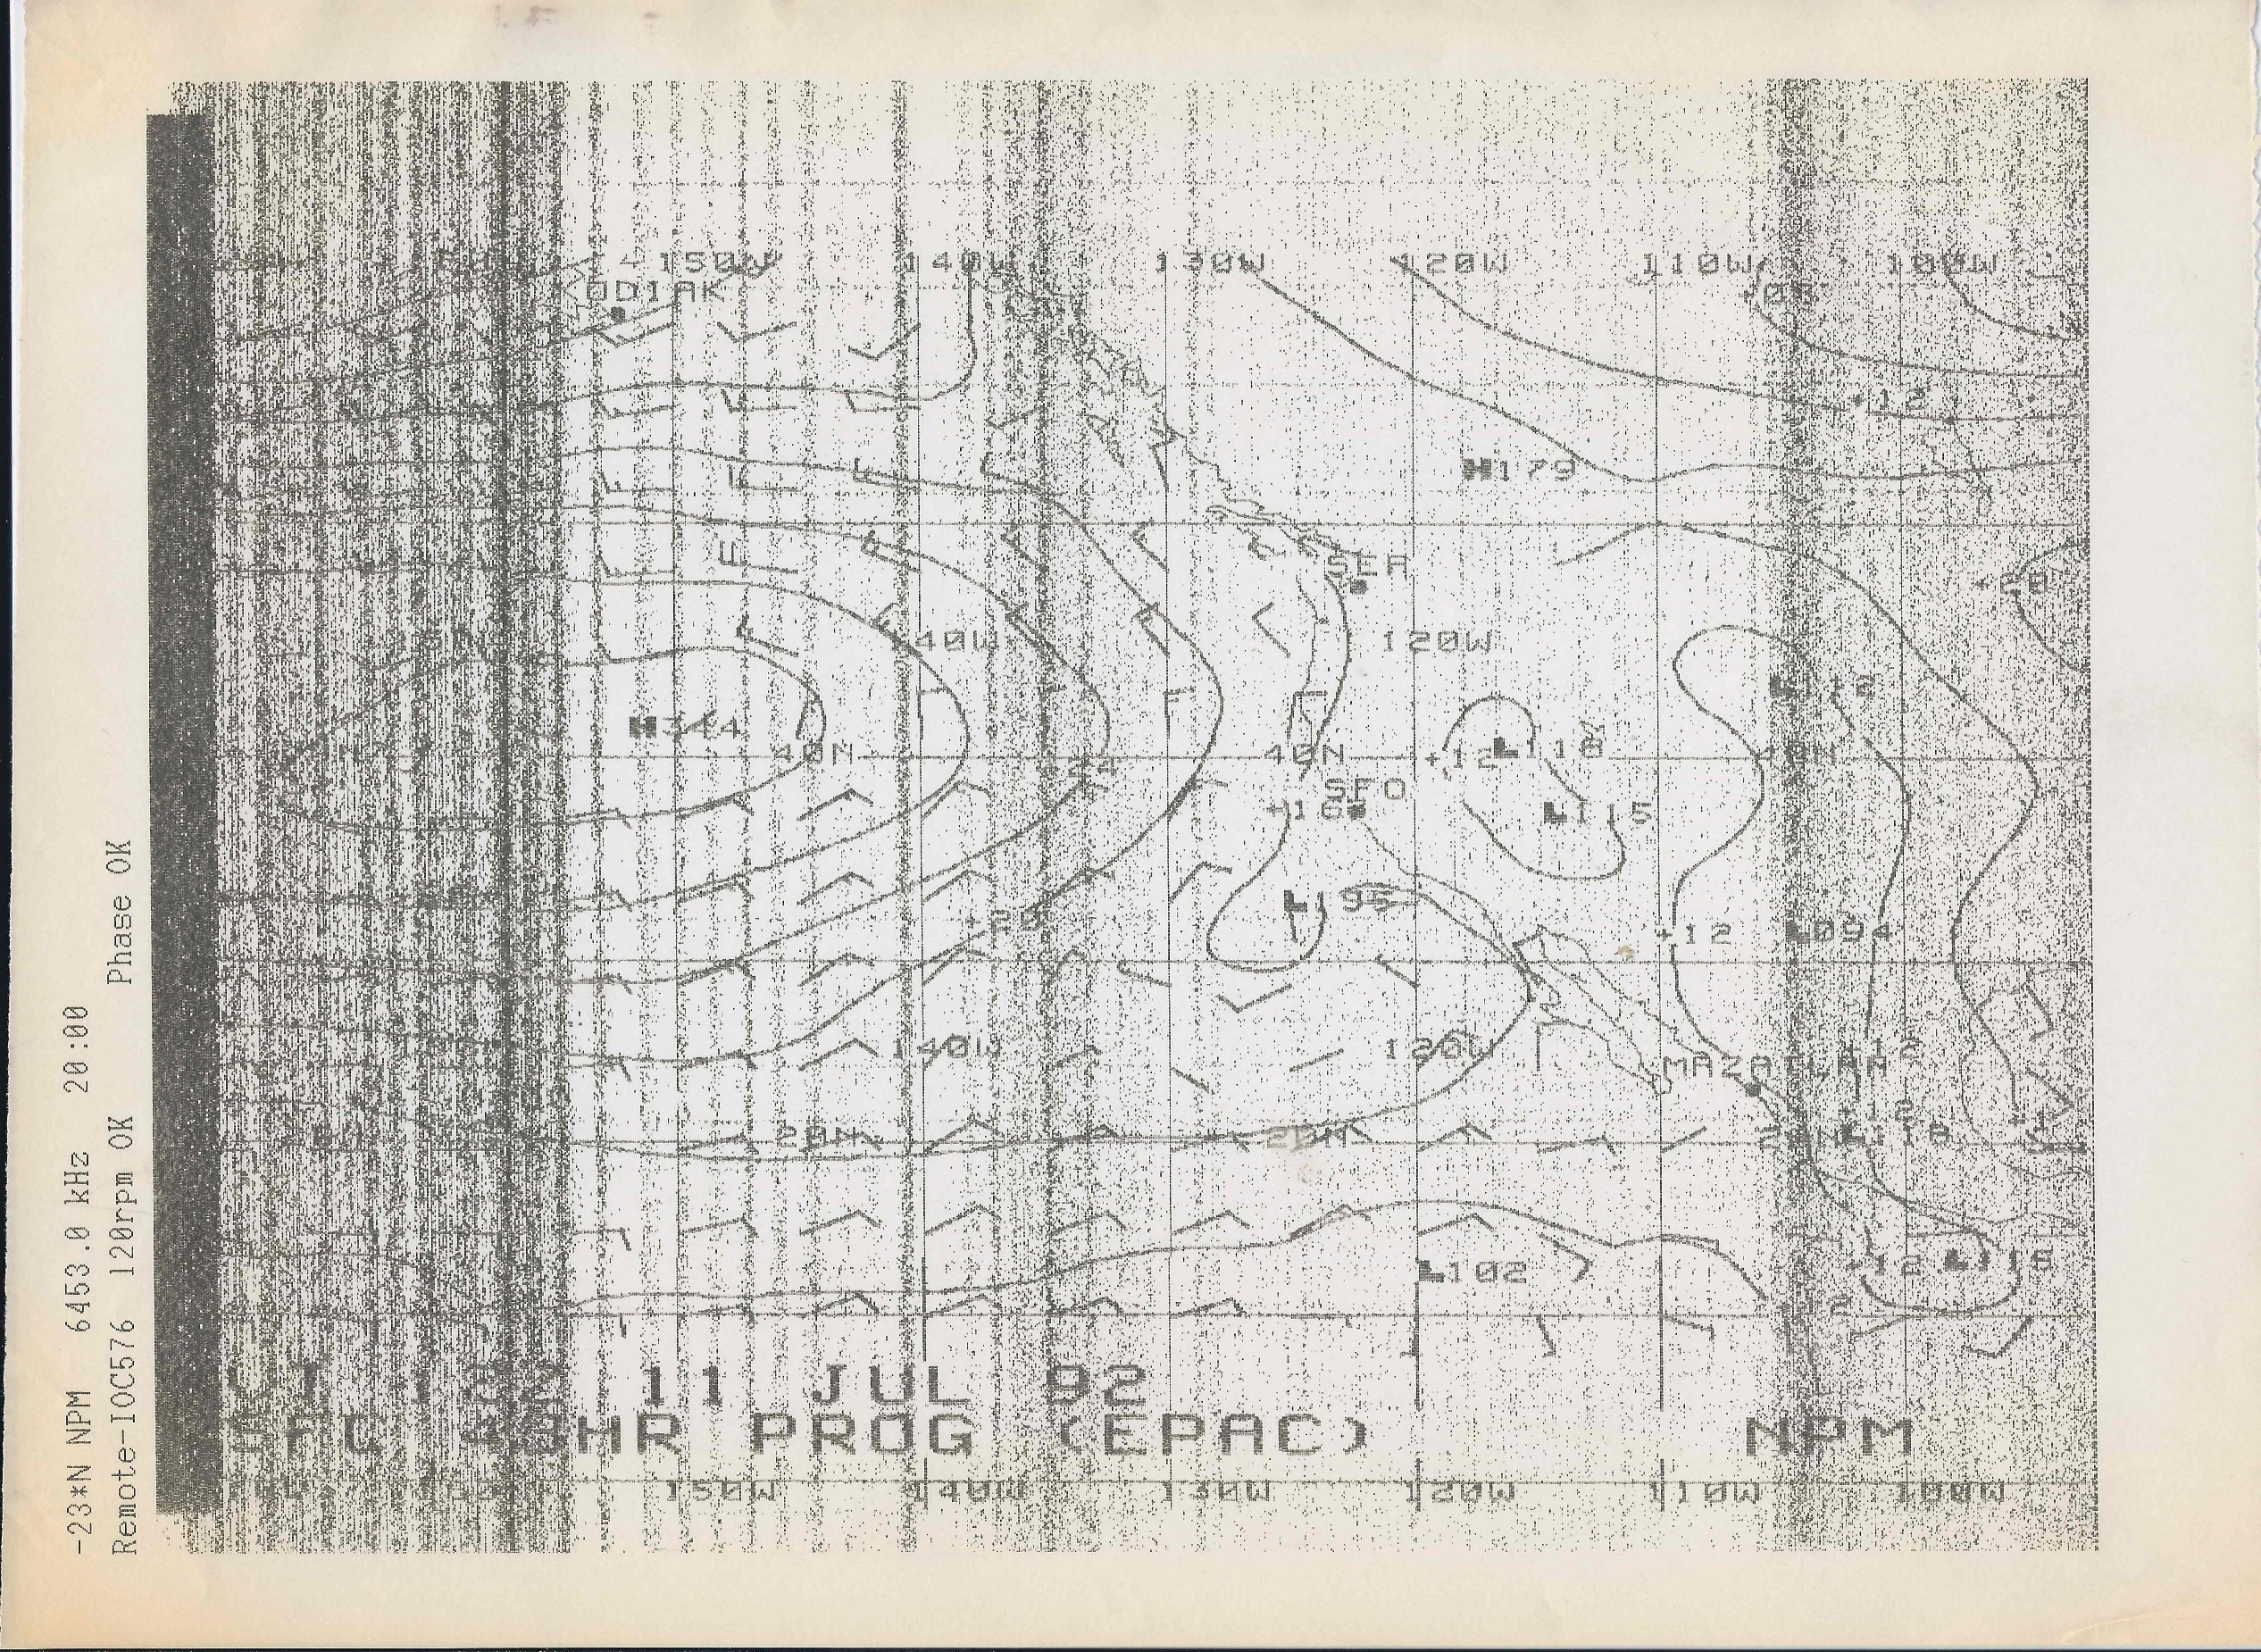

Slide 21
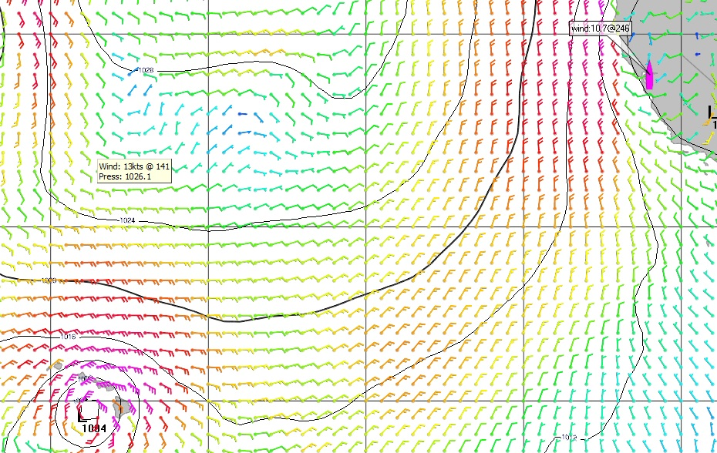

Slide 22
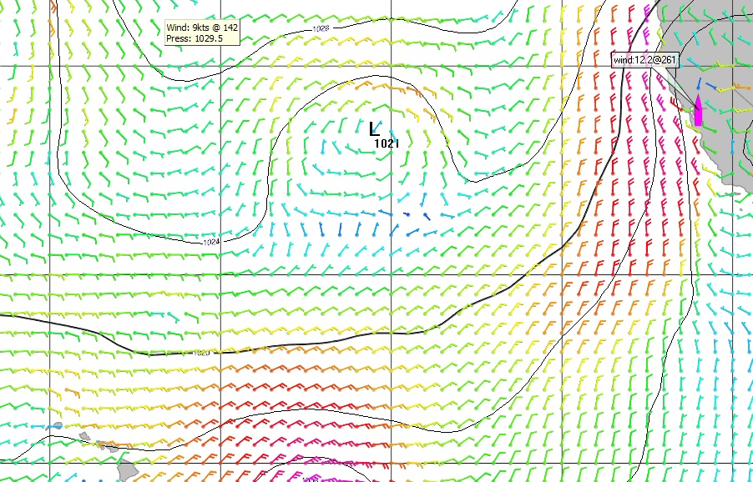

Slide 23
Race in your slot to the shift
Best ridge crossing will give you confidence to sail ocean-downwind angles, i.e. sail fast to the lift. If you get it right, you get the shift and can gybe before the wind gets too light.
If you’re too far N, sail inshore-downwind vmg angles and gybe aggressively even to slightly unfavored port poles. Decide how much to pay… 10 deg? Maybe more?
Even if you’re on perfect slot, still gybe on big shifts in squalls.
Expensive to change lanes to left, but more expensive to not do it if it’s necessary.
As everybody knows, never sail below inshore vmg angles.

Slide 24
Rules of Thumb
Never trust rules of thumb
Normal High, try to be 5-6mb away at the closest point.
4mb is dicey but ok if strong Omega Block, no mid-lat lows on their way, and High moving N.
7-8 mb might be good if zonal UL flow, incoming mid-lat lows to N, H sagging S, or H far North so it is inexpensive.

Slide 25
Tradewind Run
Nighttime dipole squalls, strong and long-lasting.
Have separate “feed”, updraft different from downdraft.
Rain before wind
“If the wind before rain, let your topsail fill again. If the rain before wind, sheets and topsails mind.”
Wind toes in at the front of dipole squalls
Simple “pop-up” daytime squalls, they grow with convection then their downdraft “cool pool” kills them. Catspaw fan-out, weaker and short-lived. Wind comes before the rain.
Simple slow/heavy boat tactic, get on port early, stay on port until squall is gone
Fast boat tactic, gybe back in front of dipole squalls.
Avoid the light air behind the squall. Port pole is best exit.

Slide 26
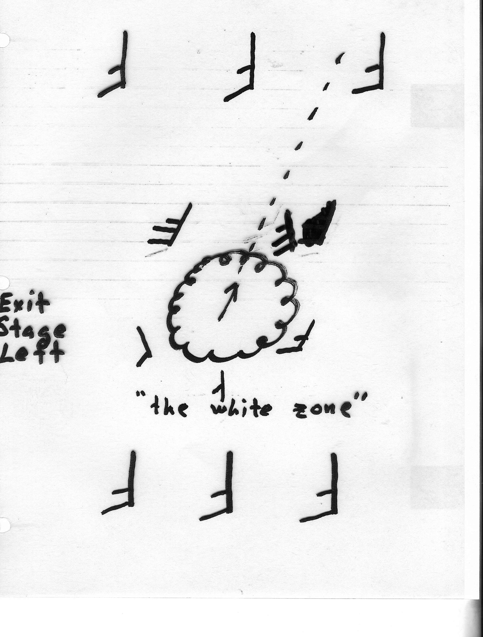

Slide 27
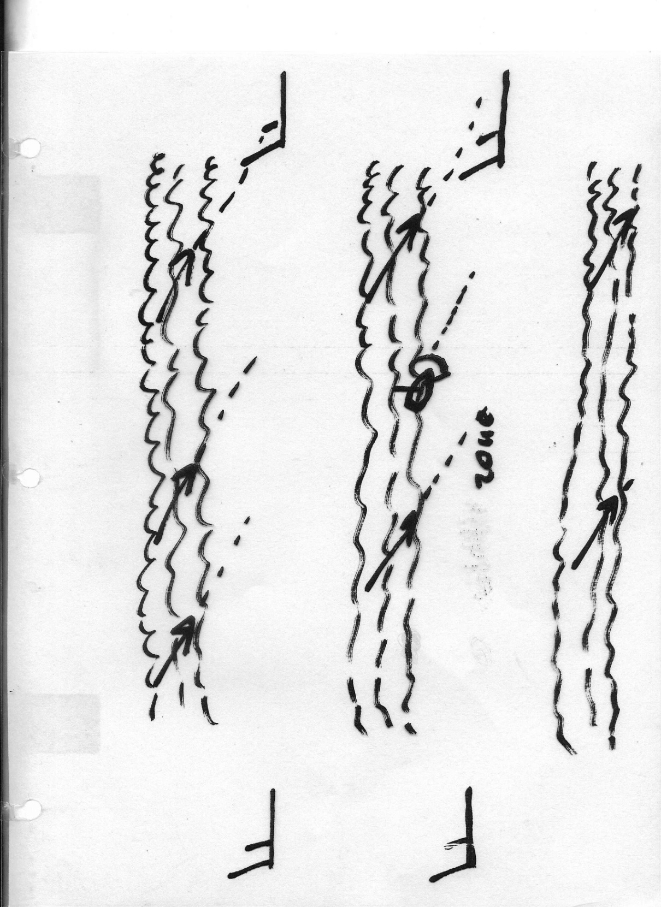

Slide 28
Tradewind Run
Daytime Cloud Streets, stay on edge of clouds. Starboard gybe will often keep you there.
Late afternoon left shift and increase around 5-6pm local.
Windy, cloudy, 3-4 hour left as you enter tradewinds, in transition zone.
Take southing if you need it.
Lots of sail handling if you don’t, as you change to JT and then back.
Often interpreted as a left-shifting, long-lasting, squall.

Slide 29
Final Shift
Right corner generally pays because of continuing veer.
Left corner pays if you are leading a tropical (inverted trough) to the finish.
Right pays big if you are following a tropical to the finish.
So keep your eye on the tropical “inverted-troughs”.
Don’t overstand, wind will build and veer.

Slide 30
Finish
Navigate to the finish buoy, don’t expect to see it until you are within a mile.
Take some bearings and plot them on the chart to confirm your GPS and improve your spatial awareness.
Test your spinnaker halyard a few miles out.
If you can’t douse: promptly jibe to starboard, sheet main in, and reach along the reef.
Navigate to the YC.

Slide 31
What if the High goes bad?
Decide whether you can get to and stay in the Trades that will live on South of the ridge.
If not consider whether Trades will fill from the NW? They rarely re-fill from the S.
Sometimes it makes sense to stay above old ridge, beating in light Westerlies, to be the first to get the new trades associated with a new High coming from the NW.
Think ahead about how the trades will fill in. Trust the GFS given no alternatives.

Slide 32
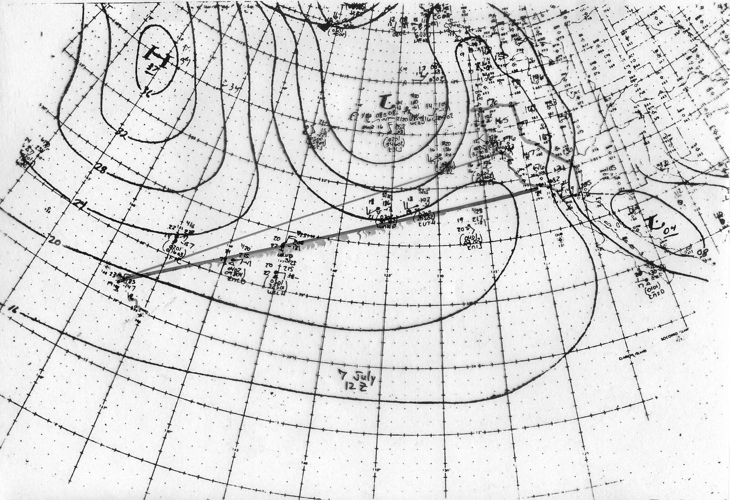

Slide 33
Resources
Community College courses
Lee Chesneau’s course (USCG license Advanced Meteorology for Masters and Mates)
Books:
C. Donald Ahrens, Meteorology Today
Jean-Yves Bernot, Bernot on Breezes
David Houghton Weather at Sea (and other books)
Ma-Li Chen and Lee Chesneau, Heavy Weather Avoidance and Route Design, Concepts and Applications of 500MB Charts
Will Oxley, Modern Race Navigation, eBook

Slide 34
Final Comments
Don’t pre-judge your route but do have a plan on the morning of the start. Reconsider and adjust as you go.
Some critical decisions occur the first night and next day.
Extra miles sailed are your currency, spend them wisely.
Don’t assume that the right answer is complicated or subtle.

